Slide 1
MEM
REPRISE
CS194H Winter 2024

Slide 2
MEM
REPRISE
CS194H Winter 2024

Slide 3
MEM
REMIX
CS194H Winter 2024

Slide 4
TABLE OF CONTENTS
01
02
03
04
Table of contents
ABOUT US
INTERFACE CHANGES
VIDEO DEMO
FUTURE WORK

Slide 5
01
ABOUT US

Slide 6


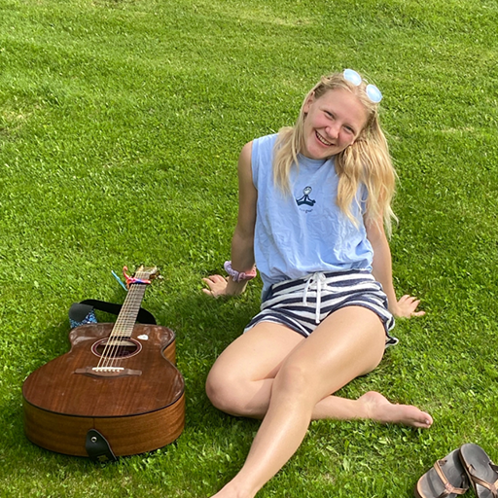


THE MEMREMIX TEAM
Casey N.
Full-stack Developer
Brent J.
Designer PM
Emily R.
Designer PM
Gray W.
Designer Developer
Tristan W.
Designer Developer

Slide 7
PROBLEM & SOLUTION
01.
02.
Music is inherently social. But, music streaming platforms today lack engaging social features amidst their seemingly endless access to music.
We want to help foster relationships through music.

Slide 8

VALUE PROPOSITION
We offer a social music-sharing mobile app where users can:
🎁 Gift songs
😲 Receive songs as gifts by surprise or in real-time
📍 Discover playlists at their pinned locations
🗺️ Tune into the music of community members nearby and around the world. (re-prioritized to V4!)

Slide 9
02
INTERFACE CHANGES

Slide 10
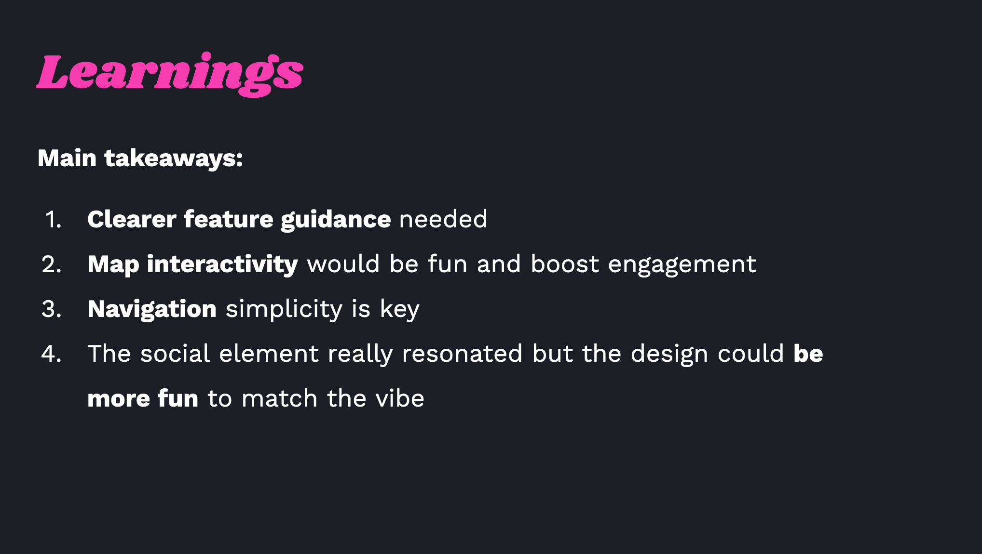

Slide 11
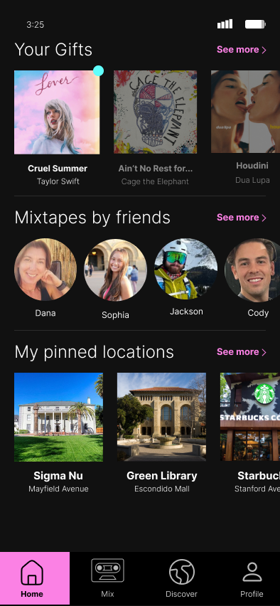
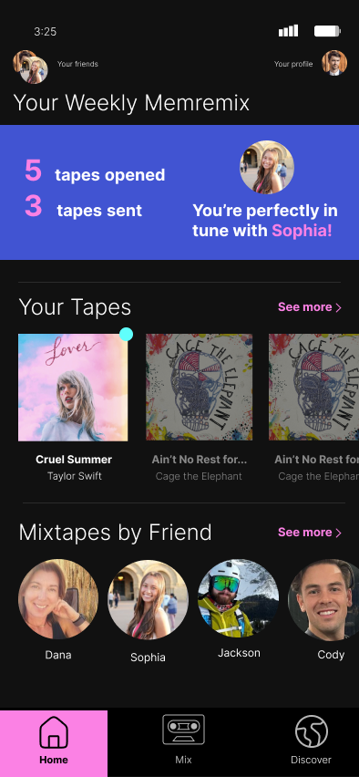
HOME SCREEN
Introduced “Your Weekly MemRemix” hero to counter “no personal investment to actively engage with the app”, Field Usability Study (Karl)
A/B tested (n = 2) access to friends versus user profile and found that users preferred a profile tab over a top menu
Removed/deprioritized “My Pinned Locations” for reasonable development expectations
Focus on friends’ faces to reiterate mission statement
Simplify!
V2:
V3:

Slide 12
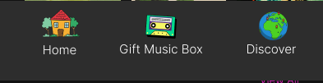
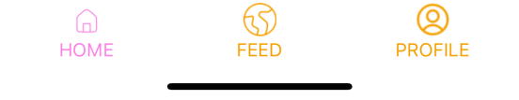
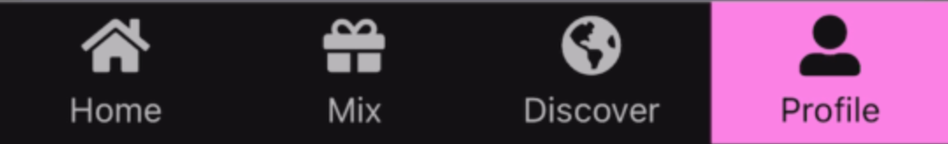
NAV BAR
V1:
Simplified our navigation schema to the profile and 3 essential words/actions: “Home” to view feed, “Mix” to send a tape, and “Discover” to view tape map based on Field Usability Feedback (Nina, Shelly, Josh, Karl)
“Discover” tab will allow us to scale to V4 community listening functionality
Focus on clean, cool icons for design consistency
V2 (tested):
V3 (lightly tested):

Slide 13
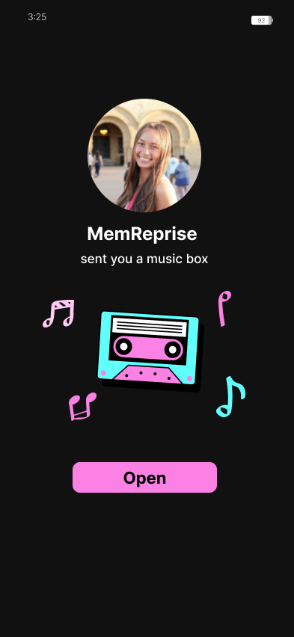
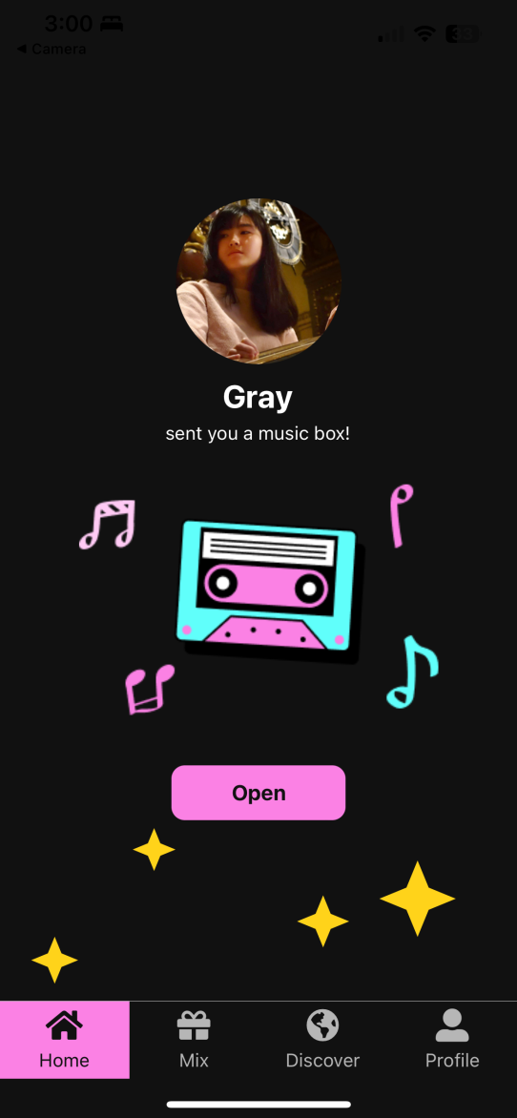
RECEIVE A TAPE
Added animation to evoke “coolness” and increase our “fun factor” per Field Usability Feedback (Karl, Josh)
V2:
V3:

Slide 14
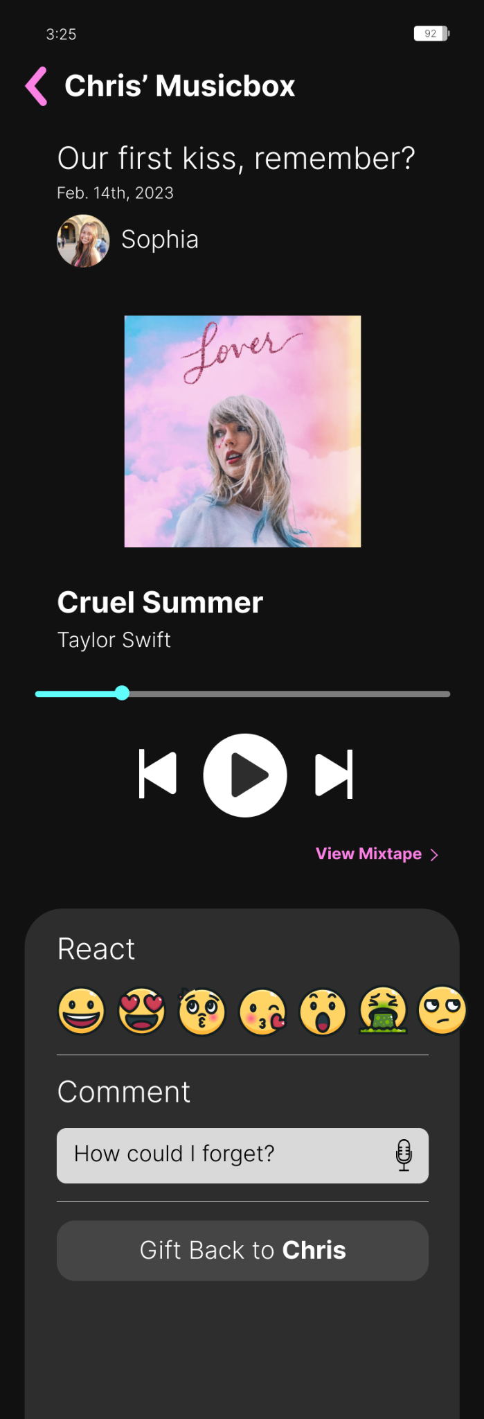
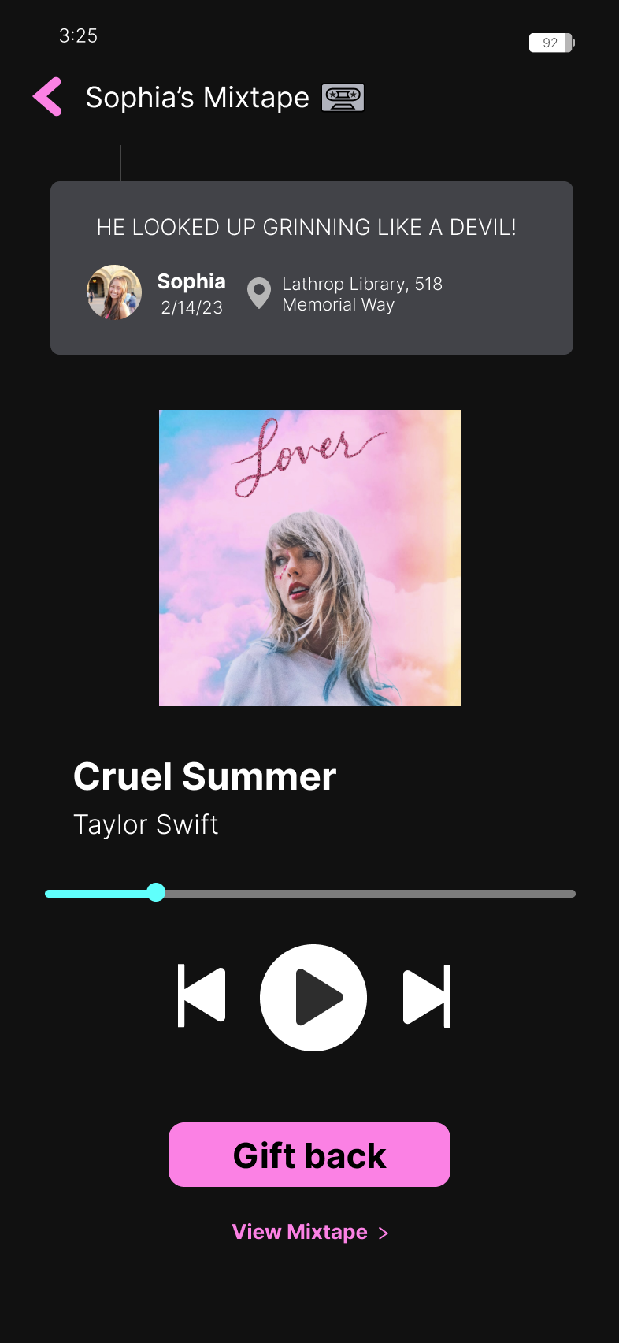
PLAY A TAPE
Navigation header revised to match new app vocabulary of “Mixtape” rather than “Musicbox”
Introduced clear design hierarchy in the Tape message so the text reads first, then friend and date, then location. New message design matches “comment” design conventions standard on other social app
“React” functionality removed/reprioritized for development feasibility
“Gift back” emphasized to encourage app’s core functionality. Used primary pink action color to reiterate app design conventions
V2:
V2.5:

Slide 15
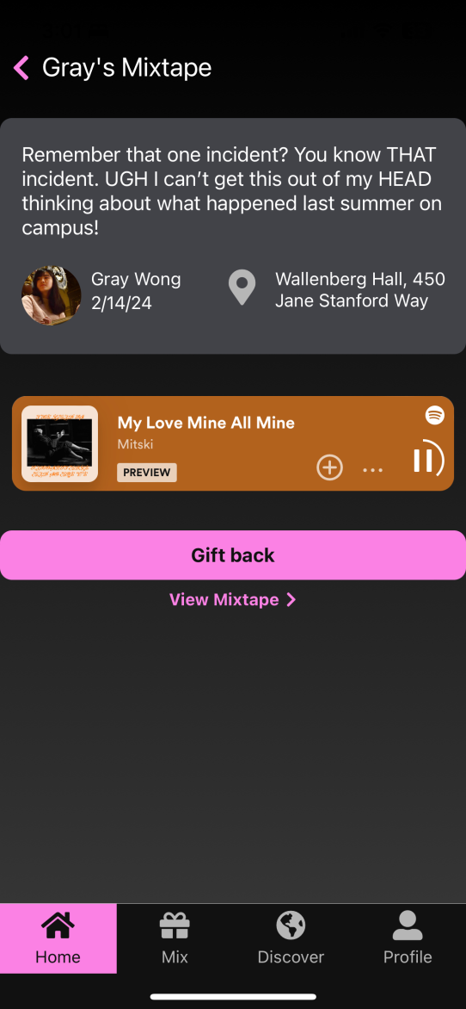
PLAY A TAPE (2)
Spacing modified based on comments (n = 2) from additional usability testing regarding complaints of it feeling too cramped
Implemented Spotify embed player so that users can actually have the ability to do something with their mixtapes and have a preview
Partially a response to Karl’s feedback on how he was unsure of how MemRemix would connect to Spotify
V2:
V2.5:
V3:

Slide 16
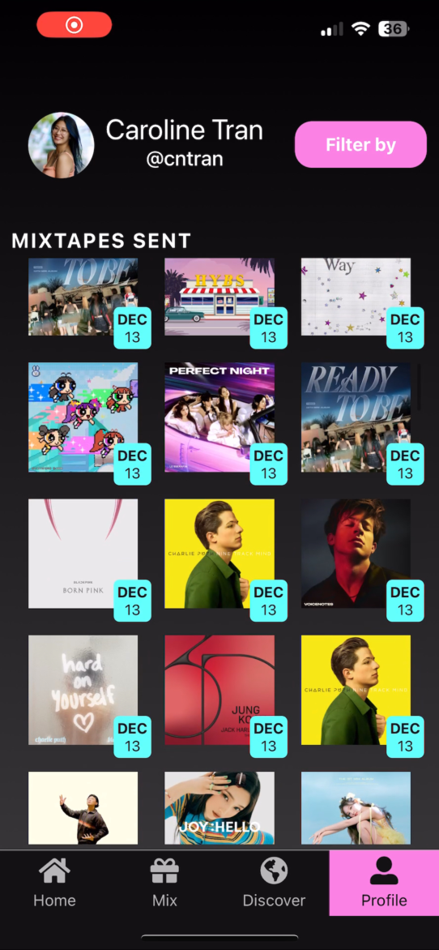
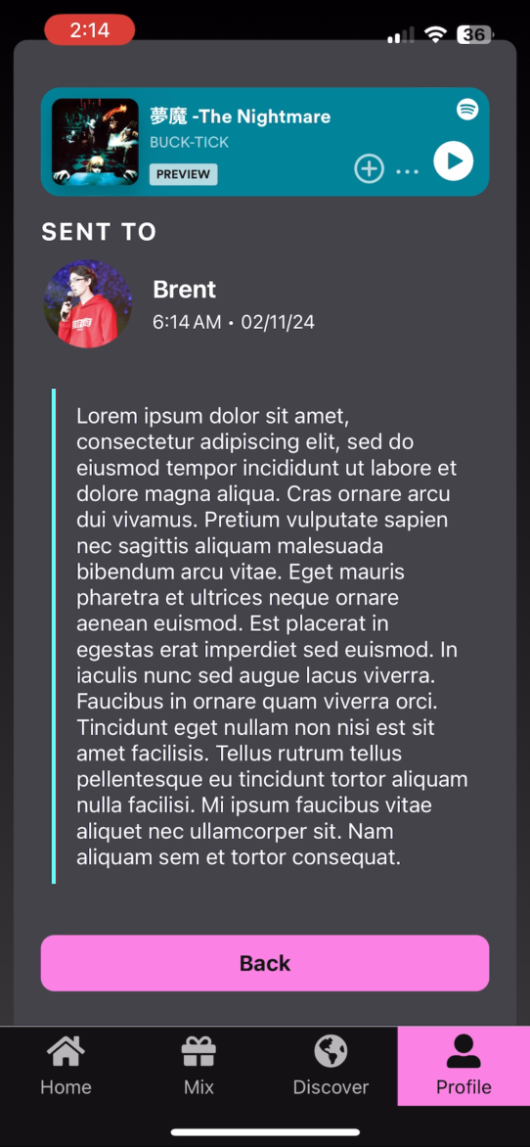
PROFILE PAGE
Reintroduced filtering based on sent mixtapes based on Karl’s and 1 bonus usability tester’s want for personal analytics and records
Simplified filtering based on initial lab study confusion where all four participants had difficulty with the reprise (filter) feature
Filtering simplified to last month, quarter, year
This is where friends and other settings would reside
V2:

Slide 17
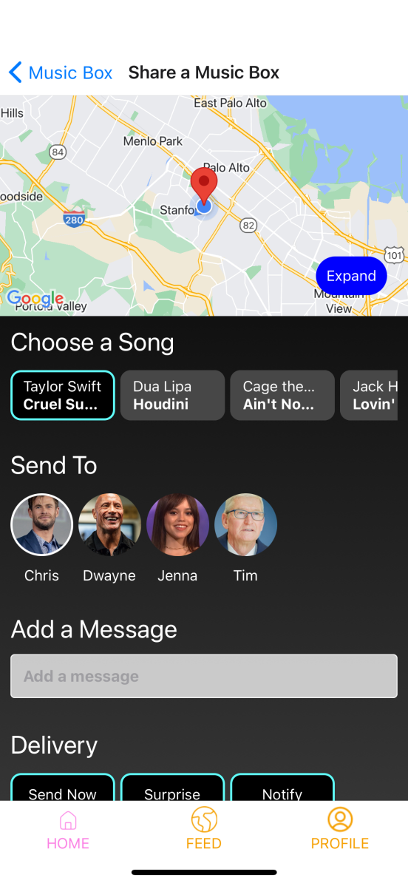
SHARING A TAPE

Slide 18
SHARING A TAPE

Slide 19
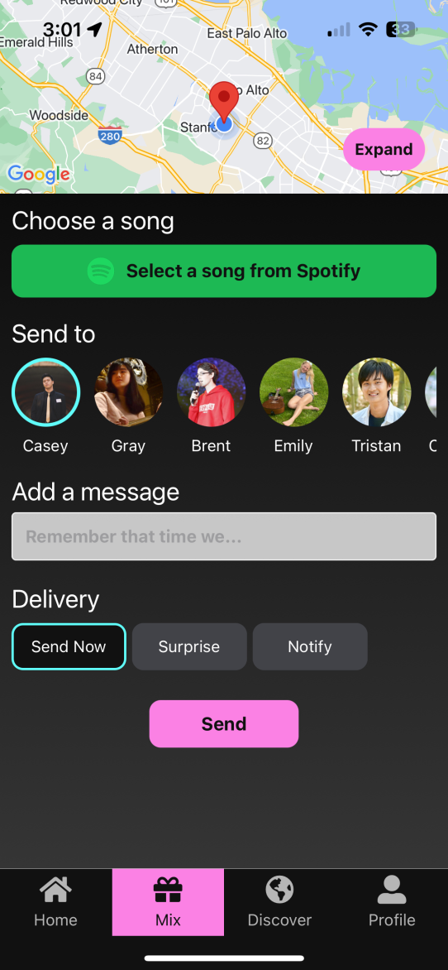
SHARING A TAPE

Slide 20
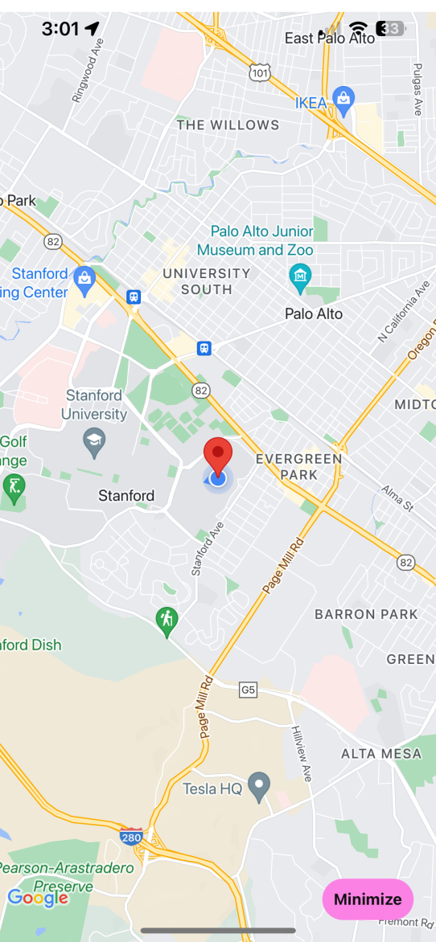
SHARING A TAPE

Slide 21
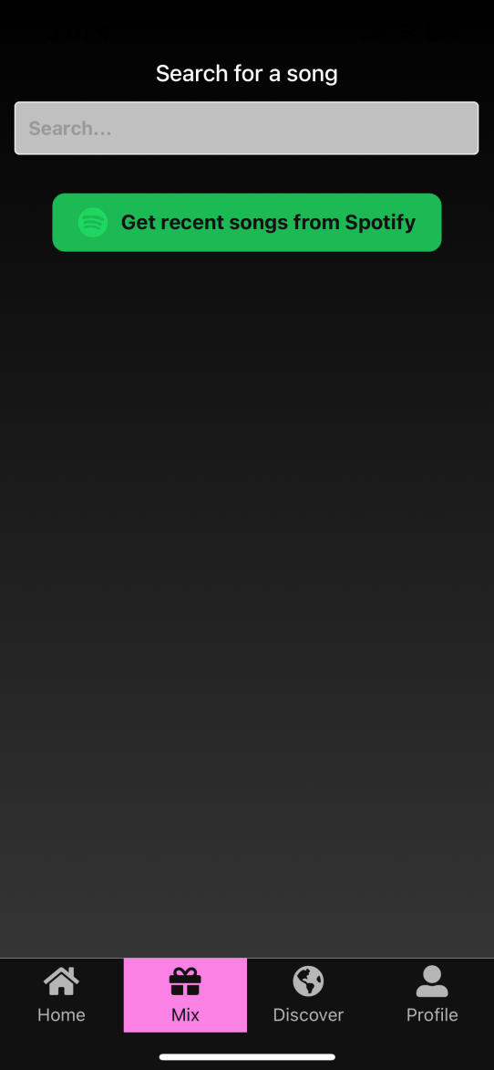
SHARING A TAPE

Slide 22
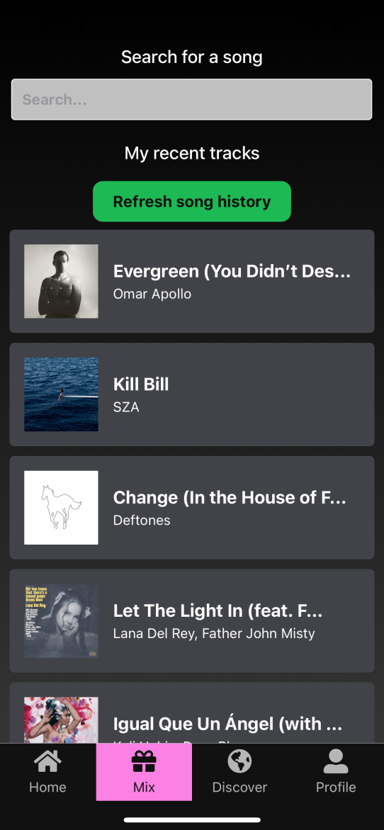
SHARING A TAPE

Slide 23
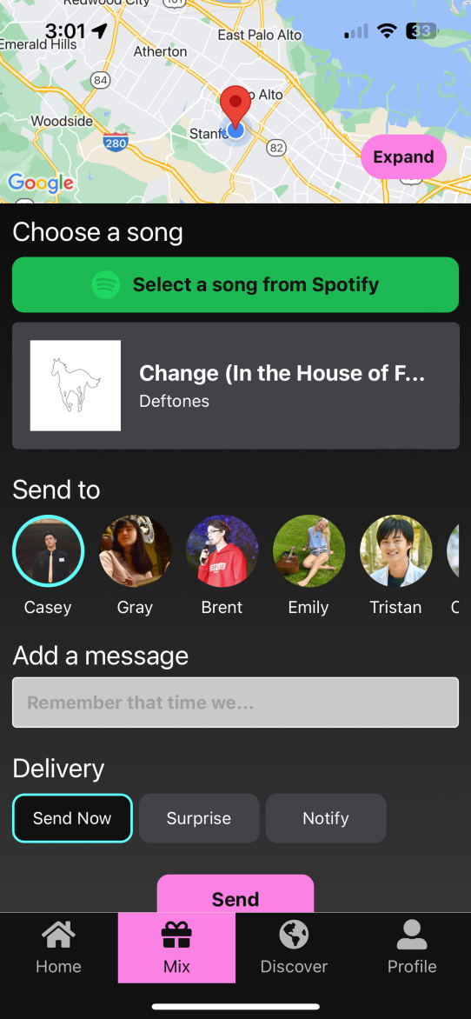
SHARING A TAPE

Slide 24
SHARING A TAPE
More of robust implementation as opposed to a static one from v2 with few UI changes
Choosing a song was broken into different steps so as to not cognitively overwhelm the user
More padding and spacing was added to contents as per 1 bonus usability tester’s feedback on the mixtape screen feeling cramped
V2:
V3:

Slide 25
03
VIDEO DEMO

Slide 26
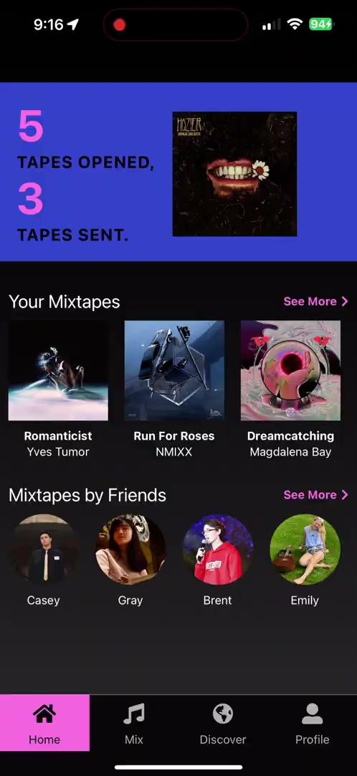
03
VIDEO DEMO
Receiving a tape

Slide 27
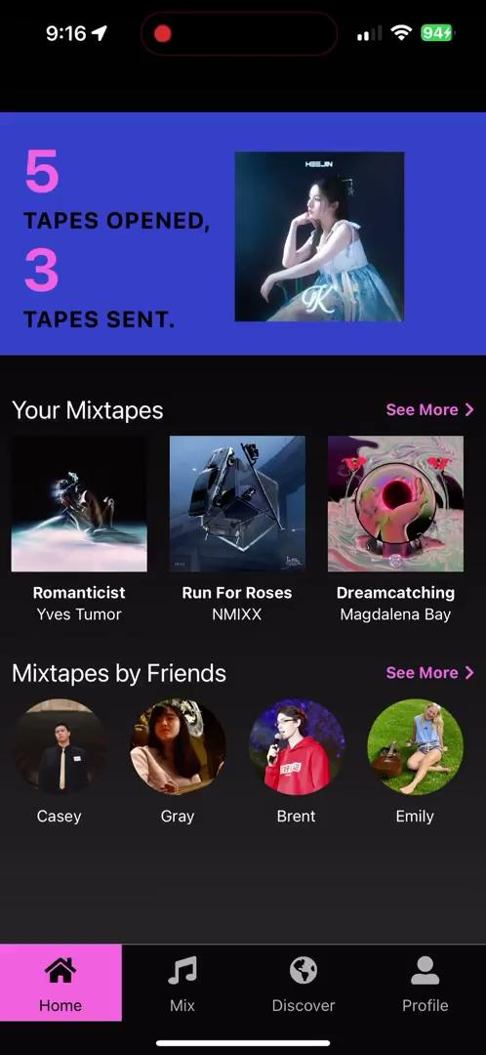
03
VIDEO DEMO
Sending a tape

Slide 28
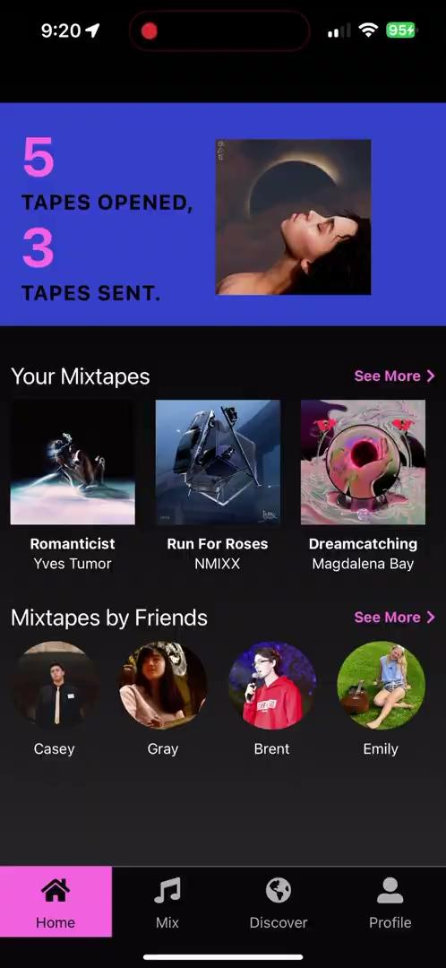
03
VIDEO DEMO
Filtering your posts

Slide 29
04
FUTURE WORK

Slide 30
UNIMPLEMENTED
MIXTAPES IN ACTION
HOME PAGE
DISCOVER MAP
Receiving and opening a music box from a real user
Hard to test with new accounts because dependent on other users’ interactions (Network effect) and location
Testing is more efficient if a user opens a hard-coded music box vs. waiting on a proctor to send them a music box from their phone
Adaptive Weekly MemRemix hero
Further stylization
Map view with surrounding mixtapes
(Though we will focus on core functionalities (sharing and viewing mixtapes) first)

Slide 31
NEXT STEPS
Receiving and opening a music box from a real user
A focus for demo day as it is core functionality
Dividing the sharing a mixtape screen into two separate screens to reduce user fatigue
Adding dummy users and mixtape tutorials
More stylization (and animations?)

Slide 32
THANKS

Slide 33
APPENDIX

Slide 34
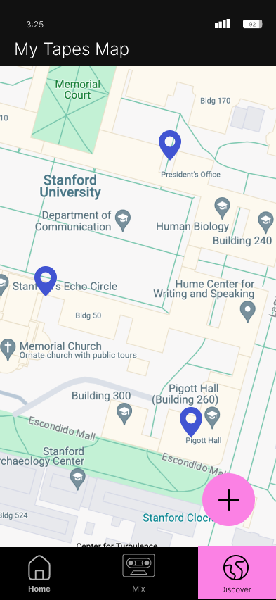
Discover - Tape Map
Defined “Discover” feature where users can see a map view all of their received tape locations per feedback “have an interactive map view with pins of tapes rather than a scroll view”, Field Usability Study (Lucas)
In the future, this “Discover” tab design structure can support community stations too
To be implemented in v4!
V2.5 (NEW!):

